Slide 1
Big Mountain Resort
Using a data driven approach to optimize revenue
Chinmaya Sukumar

Slide 2
Introduction
Resort in Montana, 350,000 skiers annually
11 lifts, 2 T-bars, 1 magic carpet amongst others
New chairlift installed - $1.54M operating cost
Additional revenue needed to recoup cost and maintain profit margin

Slide 3
How to increase revenue by at least $1.54M while keep profit margins steady and give more insight into investment strategy for the season over the next year?
Context:
New chairlift estimated cost: $1.54M
Management needs advice on how to select better value for ticket
Constraints:
Revenue of other resorts not known
Data sources:
CSV file of 330 US resorts
Criteria for success:
Select better value for ticket
Guide future investment strategy
Scope of solution space:
Leveraging data from other US resorts

Slide 4
Recommendations and Key Findings
Most important features:
Vertical drop
Snow making area capability
Total chairs
Fast quads
Runs
Big Mountain should either:
Reduce number of runs available
Invest in +1 run, +1 chairlift & increase vertical drop by 150 ft

Slide 5
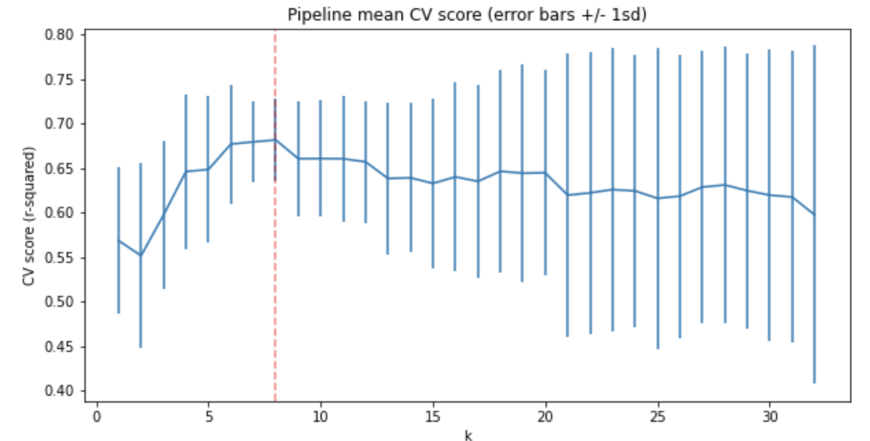
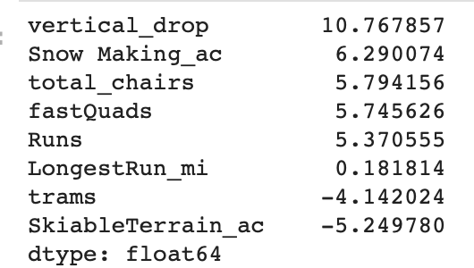
Model #1: Linear Regressor
Pipeline: Median imputer, Standard Scaler, cross-validation folds = 5
K-best features seen below, highest performance: k = 8

Slide 6
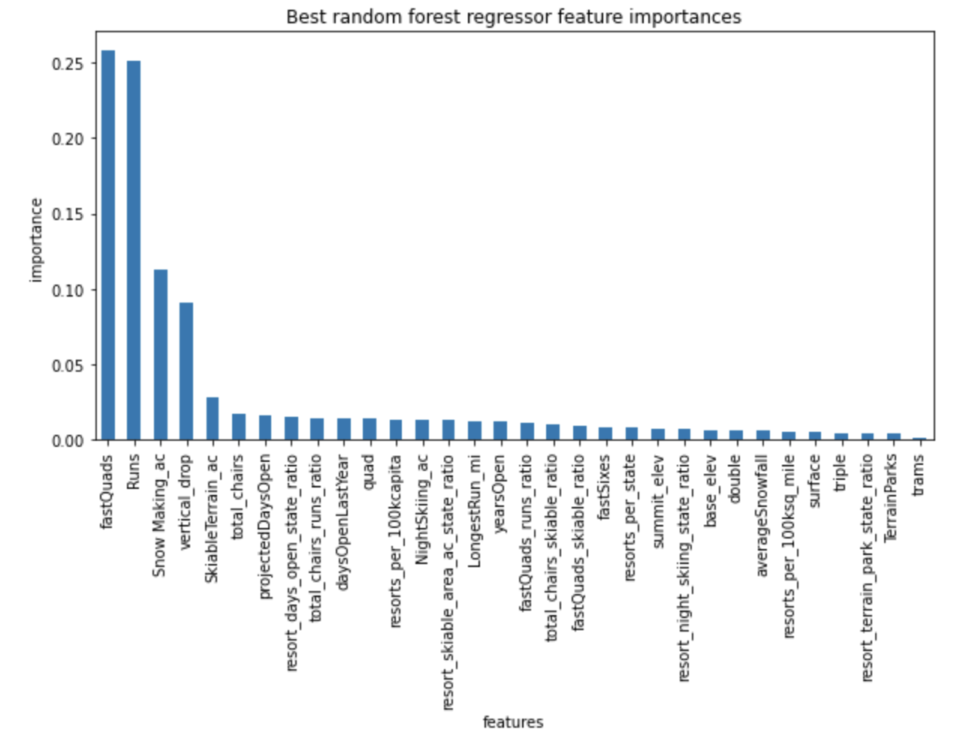
Model #2: Random Forest Regressor
Pipeline: Simple Imputer, Standard Scaler, Random Forest Regressor, folds = 5
MAE:
Model #1: 11.8
Model #2: 9.5

Slide 7
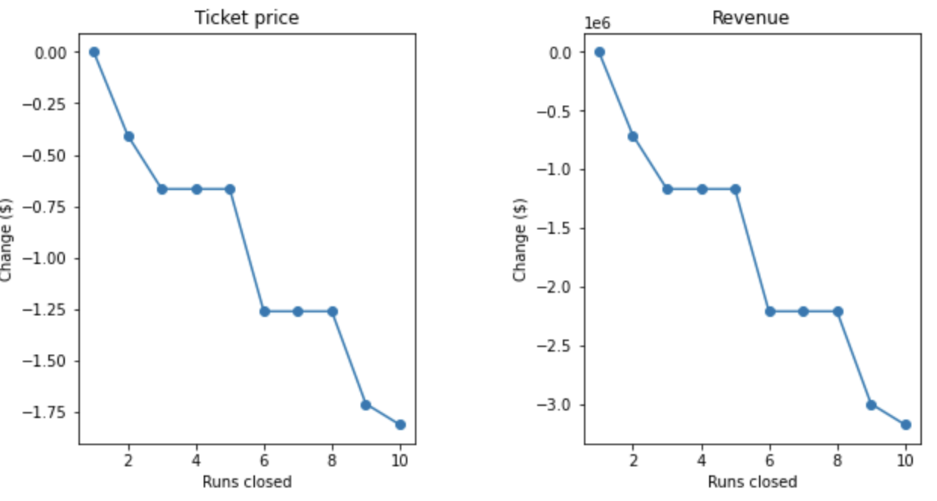
Scenario #1 - Remove up to 10 runs
Remove 1, no change in revenue
Remove 3 same change as removing 5 in revenue
Remove 6 same change as removing 8 in revenue

Slide 8
Scenario #2: +1 Run, vertical lift 150ft, +1 chairlift
Can increase ticket price by $1.99, $3.45M in revenue
Can compensate for operating cost of chairlift ($1.54M)
Scenario #3:
Scenario #2 + 2 acres snowmaking
Same increase in revenue as Scenario #1, not worth extra cost
Scenario #4: No difference in ticket price/revenue

Slide 9
Summary and Conclusion
Most viable options:
Reducing number of runs
Adding 1 run, 1 chairlift and increasing vertical drop

